Slide 1
Some points for script writing
Your oral presentation is 6 minutes maximum, so limit a word count of 900 -1.000 words at most (if you speak fast).
Always use the template for your script writing: your examiner needs to check if all the elements are included or some are missing.
Always provide sources with specific information. References at the end are only for your examiner.
Provide 5 references at least.

Slide 2
Designing Effective PowerPoint Presentations
LESSON FIVE

Slide 3
Preview
1. Big
2. Clear
3. Simple
4. Consistent
5. Progressive
6. For Your Presentation

Slide 4
1. Make it big.

Slide 5
Text
1. Big
This is Arial 12
This is Arial 18
This is Arial 24
This is Arial 32
This is Arial 36
This is Arial 44
Too Small
Smallest text
Normal text
Headline
Title

Slide 6
How to Estimate
1. Big (cont’d)
Look at it from 2 metres away
2 m

Slide 7
2. Make it clear.

Slide 8
Capitalisation
2. Clear
ALL CAPITAL LETTERS ARE DIFFICULT TO READ.
Upper and lower case letters are easier.

Slide 9
Fonts
2. Clear (cont’d)
Sanserif Z
Serif Z
clear
busy

Slide 10
Fonts
2. Clear (cont’d)
Serif fonts are difficult to read on screen.
Sanserif fonts are clearer.
Italics are difficult to read on screen.
Normal or bold fonts are clearer.
Underlines may signify hyperlinks.
Instead, use colors to emphasise.

Slide 11
Numbers
2. Clear (cont’d)
Use numbers for lists with sequence.
For example:
How to put an elephant into a fridge?
1. Open the door of the fridge.
2. Put the elephant in.
3. Close the door.

Slide 12
Numbers
2. Clear (cont’d)
How to put a giraffe into a fridge?
1. Open the door of the fridge
2. Take out the elephant
3. Put the giraffe in
4. Close the door

Slide 13
Bullets
2. Clear (cont’d)
Use bullets to show a list without:
Priority
Sequence
Hierarchy...

Slide 14
Colors
2. Clear (cont’d)
Use contrasting colors
Light on dark vs dark on light
Use complementary colors

Slide 15
Contrast
2. Clear (cont’d)
Use contrasting colors
Light on dark vs dark on light
Use complementary colors
high contrast
low contrast

Slide 16
Contrast
2. Clear (cont’d)
Use contrasting colors
Light on dark vs dark on light
Use complementary colors
This is dark on light

Slide 17
Complement
2. Clear (cont’d)
Use contrasting colors
Light on dark vs dark on light
Use complementary colors
These colors do not complement.

Slide 18
Complement
2. Clear (cont’d)
Use contrasting colors
Light on dark vs dark on light
Use complementary colors
These colors complement.

Slide 19

Size
2. Clear (cont’d)
Size implies importance.
No
Yes

Slide 20
3. Keep it simple.

Slide 21
Text
3. Simple
Too many colors
Too Many ^{Fonts} and _{Styles}
The 6 x 7 rule:
No more than 6 lines per slide
No more than 7 words per line

Slide 22
Text
3. Simple (cont’d)
Instructional Technology: A complex integrated process involving people, procedures, ideas, devices, and organization, for analyzing problems and devising, implementing, evaluating, and managing solutions to those problems in situations in which learning is purposive and controlled (HMRS 5th ed.)
Too detailed !

Slide 23
Text
3. Simple (cont’d)
Instructional Technology:
- Being used as a process
- Involving people, procedures & tools
- Providing solutions to learning problems
(HMRS 5th ed.)
Much Simpler

Slide 24
Table
3. Simple (cont’d)
Month | Delhi | Mumbai | Goa
January | 11,532,234 | 14,123,654 | 3,034,564
February | 1,078,456 | 12,345,567 | 16,128,234
March | 17,234,778 | 6,567,123 | 16,034,786
April | 16,098,897 | 10,870,954 | 7,940,096
May | 8,036,897 | 10,345,394 | 14,856,456
June | 16,184,345 | 678,095 | 4,123,656
July | 8,890,345 | 15,347,934 | 18,885,786
August | 8,674,234 | 18,107,110 | 17,230,095
September | 4,032,045 | 18,923,239 | 9,950,498
October | 2,608,096 | 9,945,890 | 5,596,096
November | 5,864,034 | 478,023 | 6,678,125
December | 12,234,123 | 9,532,111 | 3,045,654
Too detailed !

Slide 25
in millions
3. Simple (cont’d)
Table
Month | Delhi | Mumbai | Goa
January | 11 | 14 | 3
February | 1 | 12 | 16
March | 17 | 6 | 16
April | 16 | 10 | 7
May | 8 | 10 | 14
June | 16 | 0 | 4
July | 8 | 15 | 18
August | 8 | 18 | 17
September | 4 | 18 | 9
October | 2 | 9 | 5
November | 5 | 0 | 6
December | 12 | 9 | 3
Much Simpler

Slide 26
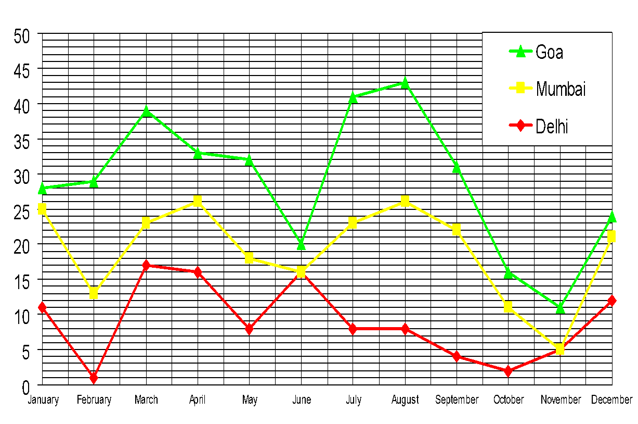
3. Simple (cont’d)
Graph
Too detailed !

Slide 27
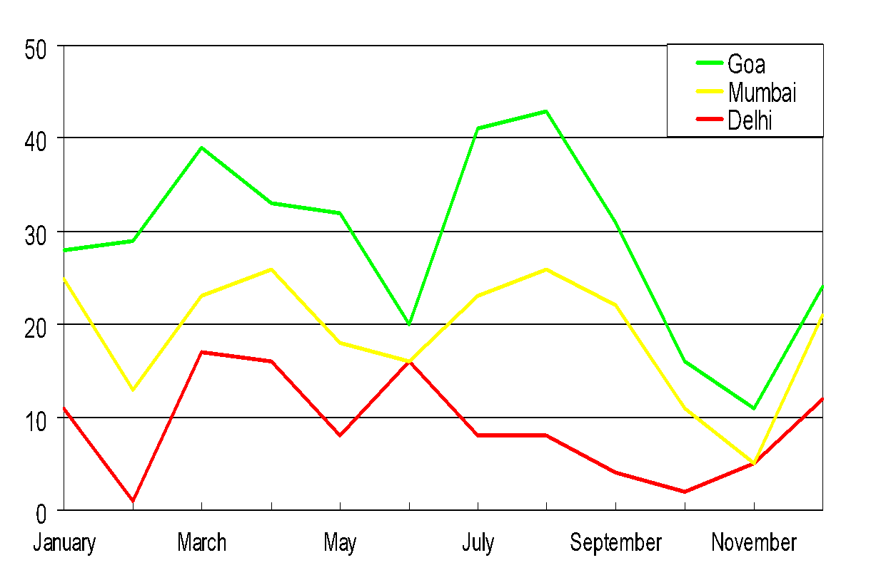
3. Simple (cont’d)
Graph
Much Simpler

Slide 28






3. Simple (cont’d)
Pictures
Art work may distract your audience.
Artistry does not substitute for content.

Slide 29



Sound
3. Simple (cont’d)
Sound effects may distract too.
Use sound only when necessary.

Slide 30
Transition
3. Simple (cont’d)
This transition is annoying, not enhancing.
"Appear" and "Disappear" are better.

Slide 31
Animation
3. Simple (cont’d)
2 m
Too distracting !

Slide 32
Animation
3. Simple (cont’d)
2 m
Simple & to the point

Slide 33
4. Be consistent.

Slide 34
4. Consistent
Differences draw attention.
Differences may imply importance.
Surprises just attracts, not distracts.

Slide 35
4. Consistent (cont’d)
Differences draw attention.
Differences may imply importance.
Use surprises to attract not distract.
This tick draws attention.

Slide 36
4. Consistent (cont’d)
Differences draw attention.
Differences may imply importance.
Use surprises to attract not distract.
These differences distract!

Slide 37
4. Consistent (cont’d)
Differences draw attention.
Differences may imply importance.
Use surprises to attract not distract.
This implies importance

Slide 38
4. Consistent (cont’d)
Differences draw attention.
Differences may imply importance.
Use surprises to attract, not distract.
Confusing differences!

Slide 39
4. Consistent (cont’d)
Differences draw attention.
Differences may imply importance.
Use surprises to attract, not distract.
This surprise attracts!

Slide 40
4. Consistent (cont’d)
Differences draw attention
Differences may imply importance
Use surprises to attract not distract
These distract!

Slide 41
5. Be progressive.

Slide 42

Understanding Technology
5. Progressive
Hard to identify!
Monitor
CPU
Function key
User interface
Keyboard
Mouse

Slide 43
Understanding Technology
5. Progressive (cont’d)
Easier to identify!
Monitor
CPU
Function key
User interface
Keyboard
Mouse

Slide 44
REVIEW
Your slides and their contents should be:
Big:
Clear:
Simple:
Consistent:
Progressive:
text sizes, animation…
fonts, styles, colors, order/sequence, pictures ..
text, layout, graphs, charts, arts, animations…
numbers, bullets, differences… in logical order
step-by-step slide display

Slide 45
Some more words
Don’t read the slides word-for-word; use them for reference only.
Direct your words to all audience in the room.
Speak loudly and clearly.

Slide 46
6. For Your Presentation
For a presentation with three Points (let’s suppose one slide for each Point), how many slides do you need in total?
Slide 1: Title + Presenter (full name + position/job)
Slide 2: Preview/Outline/Overview
Slide 3: Point 1
Slide 4: Point 2
Slide 5: Point 3
Slide 6: Review
Slide 7: References
Slide 8: Q & A
Slide 9: Thank you
Notes:
Slide 1: Title is not the topic you are given; it is a phrase that suggests the content of your presentation.
Example: Topic: Plan and deliver the introduction of an informative speech about the current Coronavirus epidemic to an audience that have NEVER heard about this serious issue.
Title: Covid-19 – An Ongoing Global Threat
Slide 2: Preview: Just mention three key points in a parallel structure: all noun phrases, verb phrases….
Slide 3,4,5: For each point, there is a headline of one Point in order.
Example: Headline for Point 1: 1. Assumed origins of Covid-19
If you need one more slide for a Point, in the second slide, there is (Cont’d) at the end of the headline. (Cont’d) means Continued.
Example: Slide 2 of Point 1: 1. Assumed origins of Covid-19 (Cont’d)
Slide 6: Review is different from Preview: It does not only contain 3 key points but some major details about each point.
Slide 7: Provide at least 5 reliable references (no Wikipedia, no Google.com, limit the use of websites ….com). Try to search for websites … edu,; .gov; …org (popular organizations like UNESCO, WHO, VTV…)
Slide 8 + Slide 9: Template only: you will say it when you display these slides.

Slide 47
SAMPLE SLIDE DESIGN

Slide 48
VIETNAM IN THE PANDEMIC
from Zero-Covid policy to adaptation to life with Covid
Presenters:
Groups 5, 7, 8

Slide 49
Preview
The changing battle
Impacts of Covid waves
Adaptation to life with Covid
Notes:
Short, parallel phrases

Slide 50
1. The changing battle
1st wave: a series of drastic and urgent measures
World recognition, i.e. Ghen Covy song
No.2 world ranking after New Zealand
4th wave: Delta surge
Strict lockdowns
Economic decline

Slide 51
2. Impacts of Covid waves
Economy
Up to Quarter 3 (July-September)
Vietnam’s GDP ↘ 6,17%
Vietnam’s GDP ↗ 0%
⇨ Target of 6.5% seems to be out of reach
(Source: Asia.Nikkei)

Slide 52
2. Impacts of Covid waves (cont)
Education
As of September 20:
In the North: Only Hanoi and Hung Yen studying entirely online ＋ 22 other localities
In the South: Most schools switching to the online mode
(Source: vnexpress)

Slide 53
2. Impacts of Covid waves (cont)
Social life
As of September 13: vaccination rate of 5.2%
One of the region's lowest
Limited social activities, especially in HCMC
(Source: Dân Trí)

Slide 54
3. Adaptation to life with Covid
Government’s measures:
Vaccines
6.1 million: first shots
600,000: second shots
Eased travel
Green cards
Quick Covid tests
Re-opened businesses
Hanoi: businesses in green zones
HCMC: Safety regulations after September 15
(Source: Vietnam News)

Slide 55
Review
The changing battle
4th wave impacts
Safe adaptation
1st-3rdwaves: success
4th wave: struggle
Economic decline
Online learning
Restricted social activity
Vaccines
Eased travel
Re-opened business

Slide 56
References
https://www.jogh.org/documents/2021/jogh-11-03012.htm
https://www.cbsnews.com/news/coronavirus-prevention-vietnam-song-ghen-co-vy-tik-tok-challenge-about-washing-hands-quang-dang-john-oliver/
https://timesofindia.indiatimes.com/blogs/ChanakyaCode/vietnams-successful-handling-of-multiple-waves-of-coronavirus-attack
https://covid19.who.int/region/wpro/country/vn
https://www.vietnam-briefing.com/news/maintaining-operations-during-vietnams-fourth-wave-pandemic.html/
https://asia.nikkei.com/Economy/Vietnam-s-GDP-shrinks-6.17-in-Q3-hurt-by-pandemic-lockdowns
https://e.vnexpress.net/news/news/pandemic-enforces-remote-learning-in-24-of-vietnam-s-63-localities-4359097.html
https://www.reuters.com/world/asia-pacific/vietnams-biggest-city-keep-virus-curbs-flight-resumption-sought-2021-09-13/
https://vovworld.vn/en-US/news/social-distancing-will-gradually-ease-in-a-controlled-manner-pm-1030032.vov
https://www.reuters.com/business/healthcare-pharmaceuticals/vietnam-capital-hanoi-ease-coronavirus-curbs-this-week-2021 09-20/
https://vietnamnews.vn/society/1026878/hcm-city-considers-issuing-vaccine-green-cards.html
https://vietnamnet.vn/en/feature/businesses-in-green-zones-resume-operation-773114.html

Slide 57
Q&A

Slide 58
THANK YOU

Slide 59
Assignment
Design slides for IU culture
Links to submit
Group 23
https://drive.google.com/drive/folders/1wXi7nNrRFBgMlKYk4GK3VeB3HrxTAYOR?usp=sharing
Group 24
https://drive.google.com/drive/folders/1IeF9977wQGGts3iLMBCqAuYyMsNRt168?usp=sharing

